Slide 1




Lecture 09: services in android:

Slide 2


Definition and purpose of services in android
In Android, a Service is an application component that can perform long-running operations in the background. It does not provide a user interface. Instead, a service can run in the background indefinitely, even if the component that started it is destroyed. Services are used for tasks that should continue running independently of any user interaction, such as playing music, handling network transactions, or interacting with content providers.

Slide 3

Types of services:
Types of Services in Android
Services in Android are primarily of three types:
Foreground Services: These services perform operations noticeable to the user. For instance, an app might use a service to play music in the foreground. These services must display a notification, so the user is aware of the ongoing operation.
Background Services: These services perform tasks that the user isn't directly aware of. However, since Android 8.0, the use of background services has been restricted to improve system performance and battery life.
Bound Services: A service is bound when an application component binds to it by calling bindService(). It provides a client-server interface that allows components to interact with the service, send requests, receive responses, and perform interprocess communication (IPC).

Slide 4

Real world analogy:
Foreground Services: Music Streaming App
Imagine using an app like Spotify or Google Play Music to listen to songs. While you’re using other apps or even when your screen is off, the music continues to play. This is a Foreground Service at work. The service must make its operation visible with an ongoing notification (which typically shows the song being played and basic controls), ensuring that you are aware that the app is actively using resources to play music. This is essential for services that need to keep running even when the user is not directly interacting with the app’s interface.

Slide 5

Real world analogy:
Background Services: Photo Backup Service
Consider Google Photos or Dropbox, which automatically back up photos to the cloud. This process often happens without any direct interaction from the user and can occur periodically in the background. This is a classic example of a Background Service. However, with Android 8.0 and later, these services have been largely restricted to efficiently manage battery life and system resources. These apps now often use JobScheduler to handle background tasks under system conditions that optimize battery life.

Slide 6

Job scheduler?
JobScheduler manages tasks in a way that reduces battery drain. Instead of apps having to run background services continuously to perform tasks or check for data updates, JobScheduler lets these tasks execute when optimal conditions are met. This approach reduces the number of times the device has to wake up or use resources, which conserves battery life.

Slide 7

Real world analogy:
Bound Services: Messenger App
An example of a Bound Service can be seen in apps like Facebook Messenger or WhatsApp when using their web or desktop versions. When your phone connects to these services to sync messages between your mobile device and the web or desktop app, the service acts as a server responding to requests from the client (the web/desktop app). The service provides real-time message syncing only while the client is connected, making it an example of a bound service. The connection is active, allowing for immediate interaction and data exchange as long as the client requires the service to be active.

Slide 8

Conditional execution:
With JobScheduler, developers can specify conditions or constraints under which their jobs should run. Some of these conditions include:
Network availability: A job can be set to run only when there is an active network connection or when the device is connected to an unmetered network.
Charging state: Jobs can be configured to run only when the device is charging, minimizing the impact on battery life.
Device idle state: Some tasks can be deferred until the device is idle, ensuring that user experience isn't hindered during active usage.

Slide 9

Real world analogy:
Bound Services: Messenger App
An example of a Bound Service can be seen in apps like Facebook Messenger or WhatsApp when using their web or desktop versions. When your phone connects to these services to sync messages between your mobile device and the web or desktop app, the service acts as a server responding to requests from the client (the web/desktop app). The service provides real-time message syncing only while the client is connected, making it an example of a bound service. The connection is active, allowing for immediate interaction and data exchange as long as the client requires the service to be active.

Slide 10
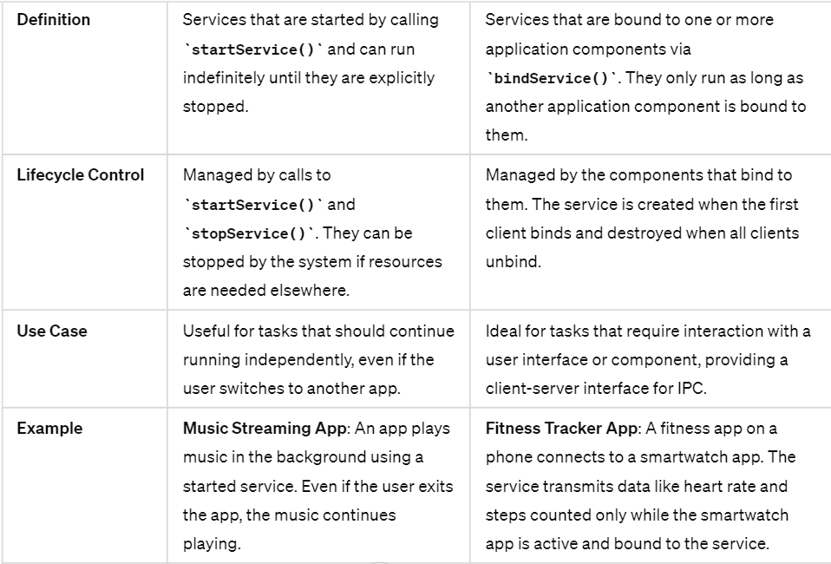
Started services vs bounded services

Slide 11
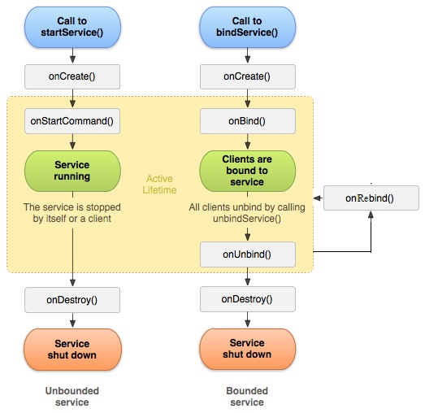
Services life cycle in android

Slide 12


Code implementation

Slide 13
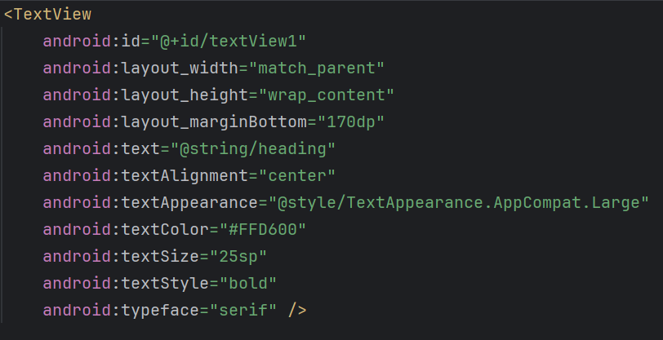
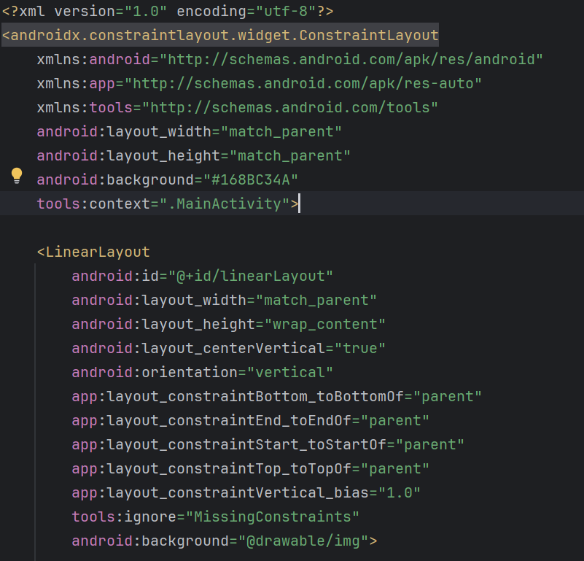
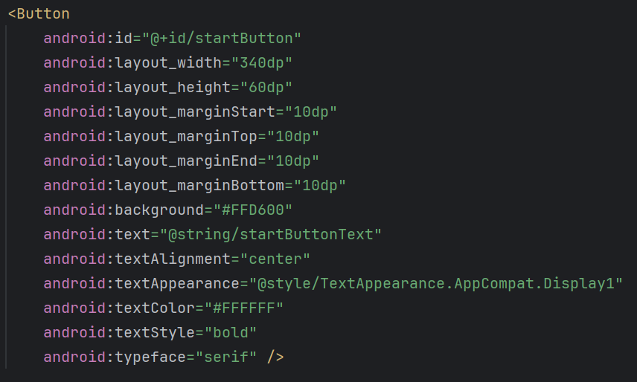
Activity.xml
Notes:
<?xml version="1.0" encoding="utf-8"?> <androidx.constraintlayout.widget.ConstraintLayout xmlns:android="http://schemas.android.com/apk/res/android" xmlns:app="http://schemas.android.com/apk/res-auto" xmlns:tools="http://schemas.android.com/tools" android:layout_width="match_parent" android:layout_height="match_parent" android:background="#168BC34A" tools:context=".MainActivity"> <LinearLayout android:id="@+id/linearLayout" android:layout_width="match_parent" android:layout_height="wrap_content" android:layout_centerVertical="true" android:orientation="vertical" app:layout_constraintBottom_toBottomOf="parent" app:layout_constraintEnd_toEndOf="parent" app:layout_constraintStart_toStartOf="parent" app:layout_constraintTop_toTopOf="parent" app:layout_constraintVertical_bias="1.0" tools:ignore="MissingConstraints" android:background="@drawable/img"> <TextView android:id="@+id/textView1" android:layout_width="match_parent" android:layout_height="wrap_content" android:layout_marginBottom="170dp" android:text="@string/heading" android:textAlignment="center" android:textAppearance="@style/TextAppearance.AppCompat.Large" android:textColor="#FFD600" android:textSize="25sp" android:textStyle="bold" android:typeface="serif" /> <Button android:id="@+id/startButton" android:layout_width="340dp" android:layout_height="60dp" android:layout_marginStart="10dp" android:layout_marginTop="10dp" android:layout_marginEnd="10dp" android:layout_marginBottom="10dp" android:background="#FFD600" android:text="@string/startButtonText" android:textAlignment="center" android:textAppearance="@style/TextAppearance.AppCompat.Display1" android:textColor="#FFFFFF" android:textStyle="bold" android:typeface="serif" /> <Button android:id="@+id/stopButton" android:layout_width="340dp" android:layout_height="61dp" android:layout_marginStart="10dp" android:layout_marginTop="10dp" android:layout_marginEnd="10dp" android:layout_marginBottom="10dp" android:background="#FFD600" android:text="@string/stopButtonText" android:textAlignment="center" android:textAppearance="@style/TextAppearance.AppCompat.Display1" android:textColor="#FFFFFF" android:textStyle="bold" android:typeface="serif" /> <ImageView android:id="@+id/imageView" android:layout_width="400dp" android:layout_height="wrap_content" android:layout_marginTop="20dp" app:srcCompat="@drawable/img_1" android:scaleType="centerCrop" /> </LinearLayout> </androidx.constraintlayout.widget.ConstraintLayout>

Slide 14
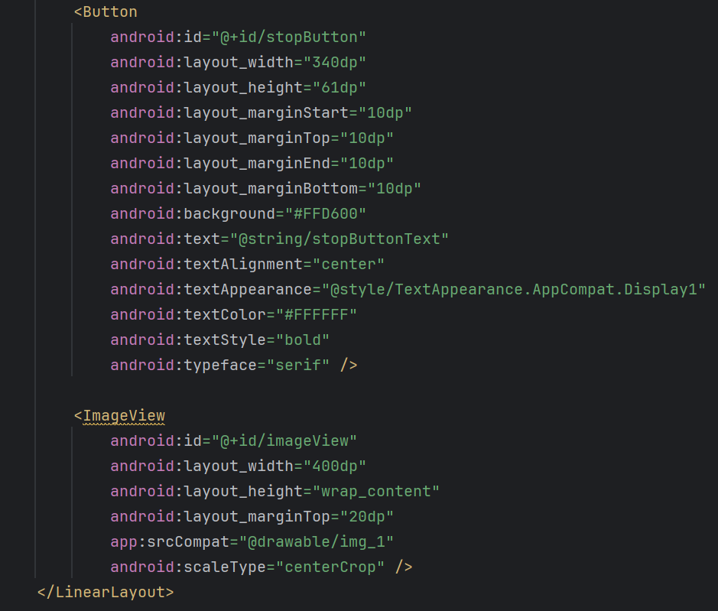
Activity.xml

Slide 15
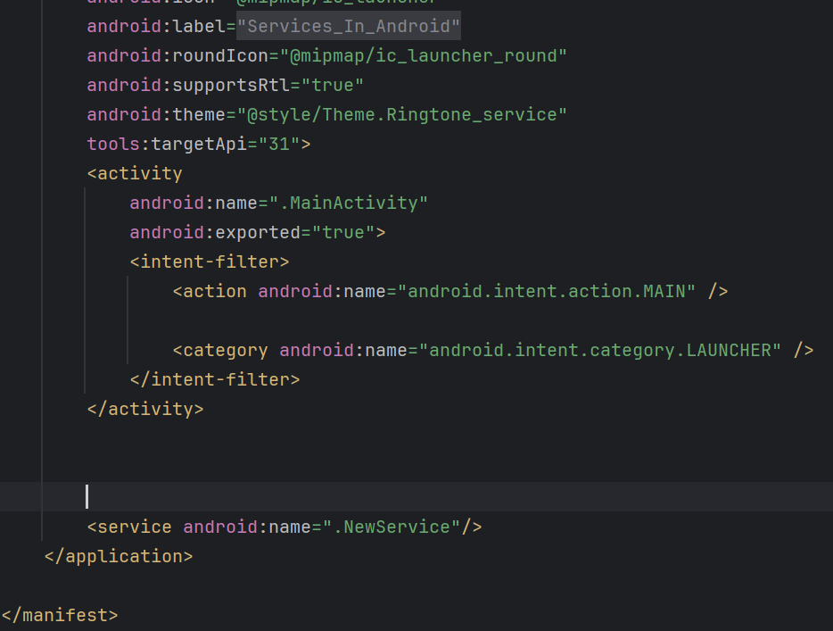
Android-Manifest.xml
Notes:
<?xml version="1.0" encoding="utf-8"?> <manifest xmlns:android="http://schemas.android.com/apk/res/android" xmlns:tools="http://schemas.android.com/tools"> <application android:allowBackup="true" android:dataExtractionRules="@xml/data_extraction_rules" android:fullBackupContent="@xml/backup_rules" android:icon="@mipmap/ic_launcher" android:label="@string/app_name" android:roundIcon="@mipmap/ic_launcher_round" android:supportsRtl="true" android:theme="@style/Theme.Ringtone_service" tools:targetApi="31"> <activity android:name=".MainActivity" android:exported="true"> <intent-filter> <action android:name="android.intent.action.MAIN" /> <category android:name="android.intent.category.LAUNCHER" /> </intent-filter> </activity> <service android:name=".NewService"/> </application> </manifest>

Slide 16
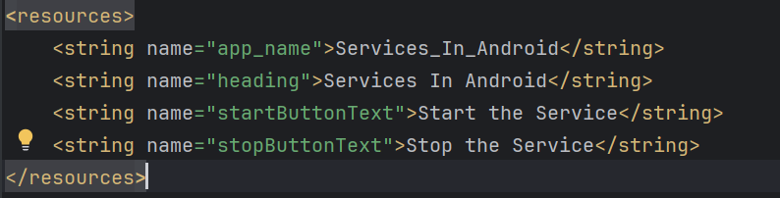
Strings resource

Slide 17
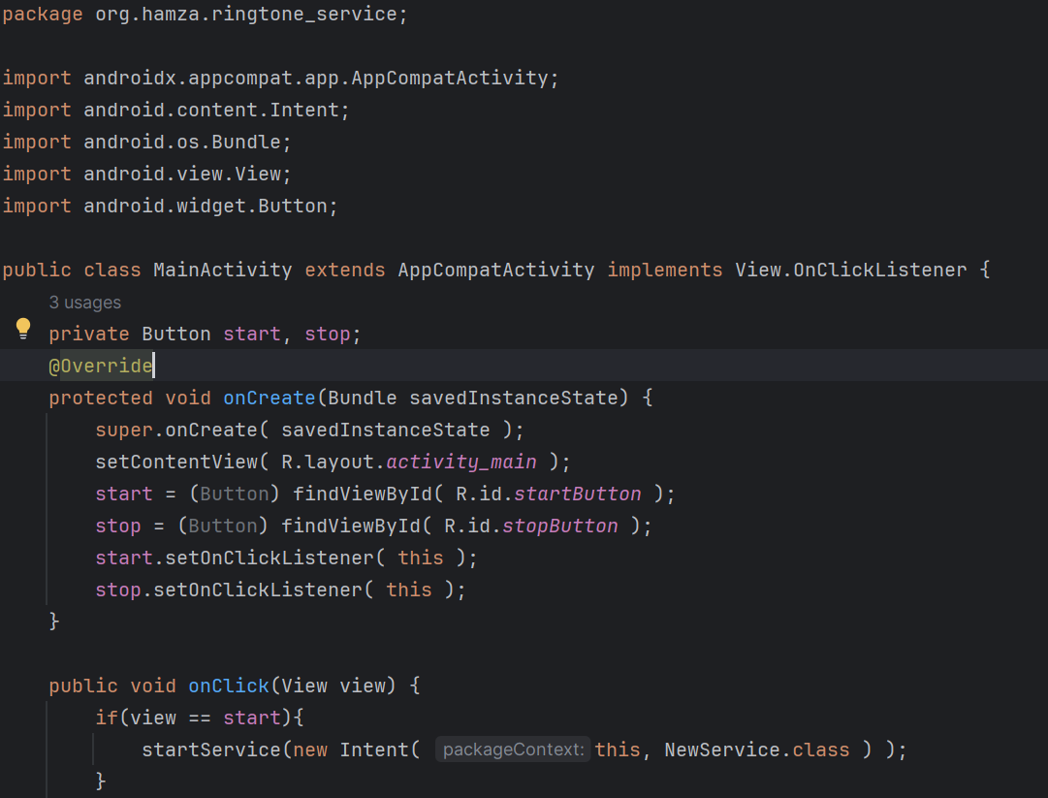
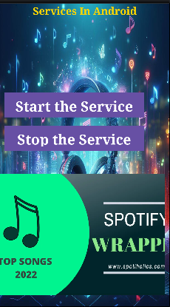
Main-activity.java

Slide 18
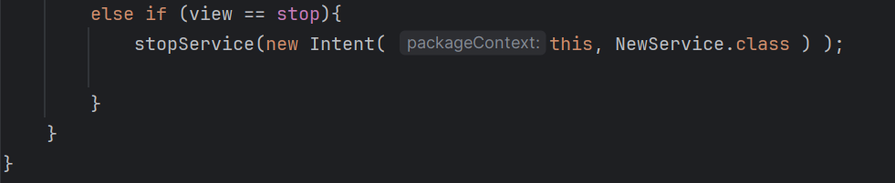
Main-activity.java

Slide 19
Start_sticky:
This makes startSticky ideal for long-running and background tasks that should be resilient to system stops.
startSticky is particularly useful for services that need to continue running across the lifecycle of the application or beyond the presence of any specific activity
USECASE:
Media Players: Services that manage media playback where you want the media to resume if the service is unexpectedly stopped.

Slide 20
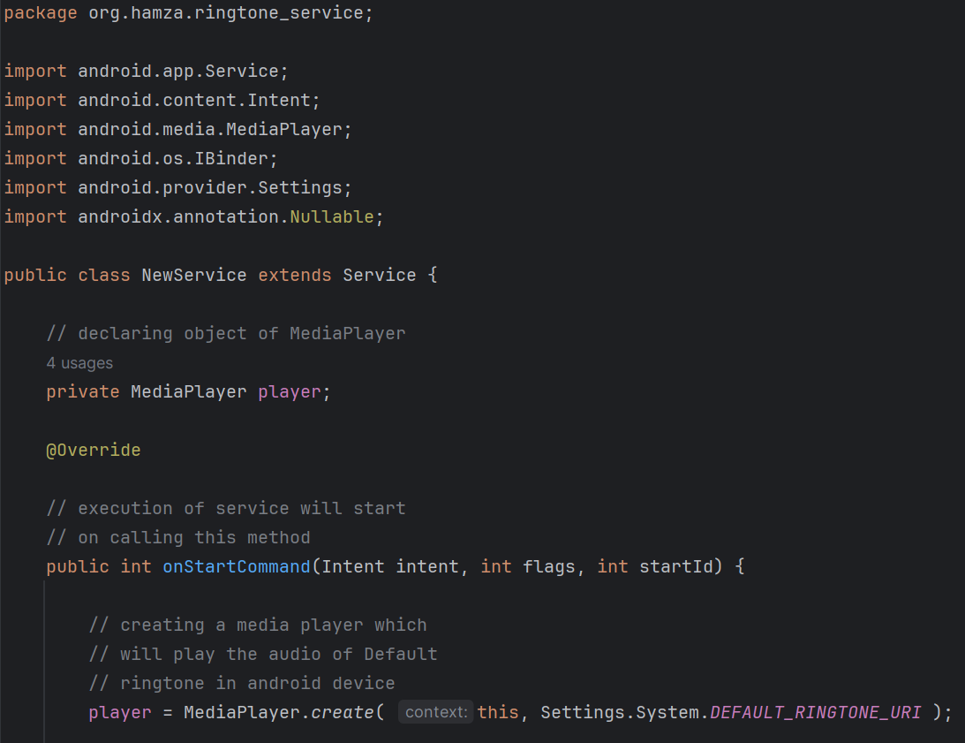
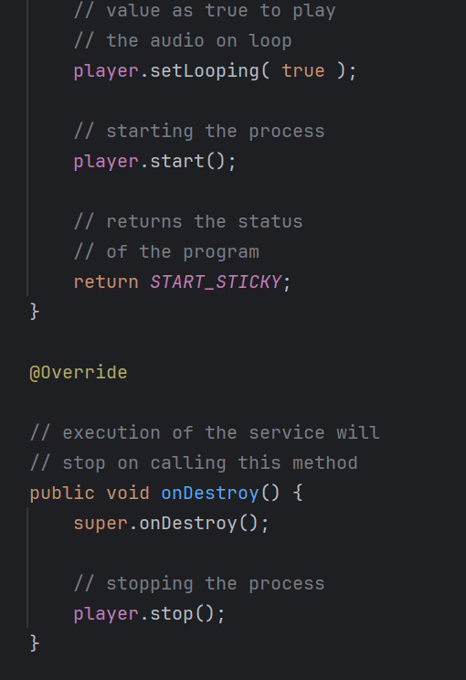
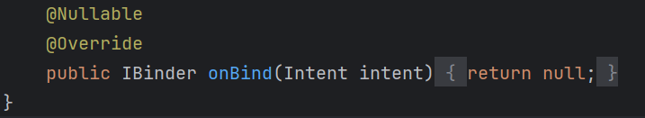
Service class code
Notes:
package org.hamza.ringtone_service; import android.app.Service; import android.content.Intent; import android.media.MediaPlayer; import android.os.IBinder; import android.provider.Settings; import androidx.annotation.Nullable; public class NewService extends Service { // declaring object of MediaPlayer private MediaPlayer player; @Override // execution of service will start // on calling this method public int onStartCommand(Intent intent, int flags, int startId) { // creating a media player which // will play the audio of Default // ringtone in android device player = MediaPlayer.create( this, Settings.System.DEFAULT_RINGTONE_URI ); // providing the boolean // value as true to play // the audio on loop player.setLooping( true ); // starting the process player.start(); // returns the status // of the program return START_STICKY; } @Override // execution of the service will // stop on calling this method public void onDestroy() { super.onDestroy(); // stopping the process player.stop(); } @Nullable @Override public IBinder onBind(Intent intent) { return null; } }

Slide 21
Output:

Slide 22

TASK: 1
Background Music Player Service:
Scenario: Ali loves to listen to music on his Android device, even when He's using other apps. He wants to create a background music player service that continues playing music even when he switches to a different app.
Task:
Ali opens his music player app on his Android device.
He selects a playlist and starts playing music.
Ali switches to another app, such as a messaging app, to reply to a message.
Despite switching to another app, the music continues playing in the background, thanks to the background music player service He implemented.

Slide 23

TASK 2:
File Download Service:
Scenario: Hamza is developing a file download manager app for Android. He wants to create a service that handles downloading files in the background, allowing users to initiate downloads and monitor their progress without keeping the app open.
Task:
Hamza's file download manager app displays a list of files available for download.
When a user selects a file to download, the app starts a file download service in the background.
The file download service retrieves the file from the internet and saves it to the device's storage.
The app provides real-time updates on the download progress, even if the user navigates away from the app or locks their device.

